Slide 1
PLIMs Personal learning Intention Maps

Slide 2
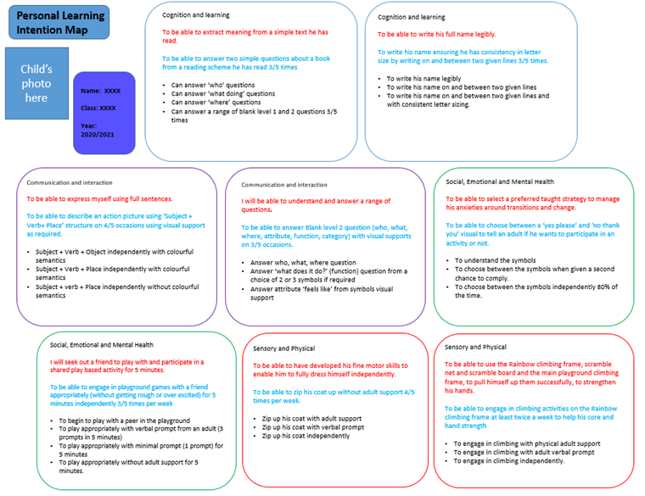
PLIM format

Slide 3
EHCP outcome examples
By the end of Key Stage 2, XXXX will be able to access and take part in a range of learning activities and make progress through the curriculum.
Steps XXXXX will take to achieve outcome: ·Complete short, differentiated activities independently. ·Maintain focus during independent working so that he completes differentiated work in the time set. ·Go through their timetable for the day and communicate if they feel it is OK or mark any lessons/activities they feel uncomfortable about. ·Indicate to an adult (in whatever way is comfortable for him) if they feel worried about completing a set activity.

Slide 4
Incorporating EHCPs
These will be taken from Section E on the EHCP.
Section E specifies the provision each child needs, and the expected outcomes.
These are end of key stage targets.
These targets are red.

Slide 5
Yearly target
We then break the key stage target down into a short term target.
This will be a target set for each child to achieve by the end of the academic year.
These targets are blue.
Where children are in their last year of a Key Stage, the end of Key Stage target will be used.
(red target)

Slide 6
Steps to success
The yearly target is broken down into manageable steps to support the children to meet their end of year target. These small steps may not be progressive.
These targets are black.

Slide 7
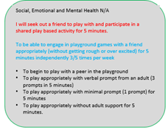
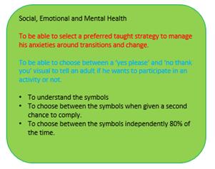
Progress
These small steps will be included in children’s learning and staff will gather evidence in a variety of formats.
Once there is enough evidence the step will be marked off.
Once the end of year target is met the box will be filled in green.
In a small number of cases an outcome may no longer be applicable in this case the box is filled in grey.

Slide 8
Evidence
Evidence against the Cognition and Learning and the Social, Emotional and Mental Health outcomes will be collected in a variety of ways, by teaching staff. This will be in the form of observations, annotated photos, videos and examples of work.
Some evidence, if appropriate will be collected against SP and CI to inform the annual review.

Slide 9
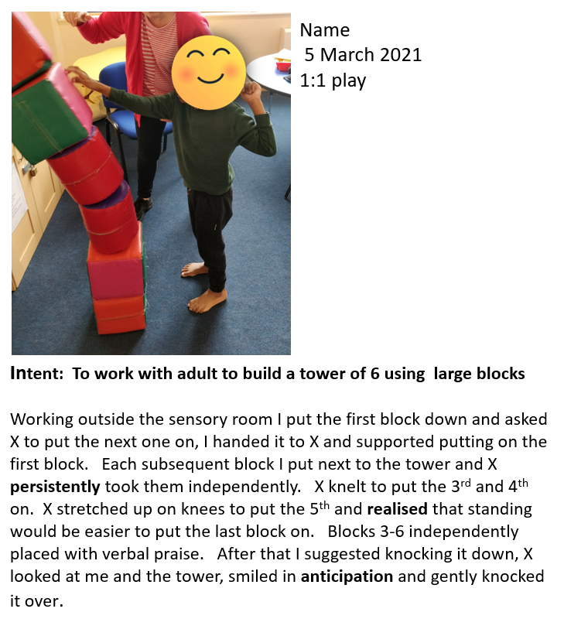
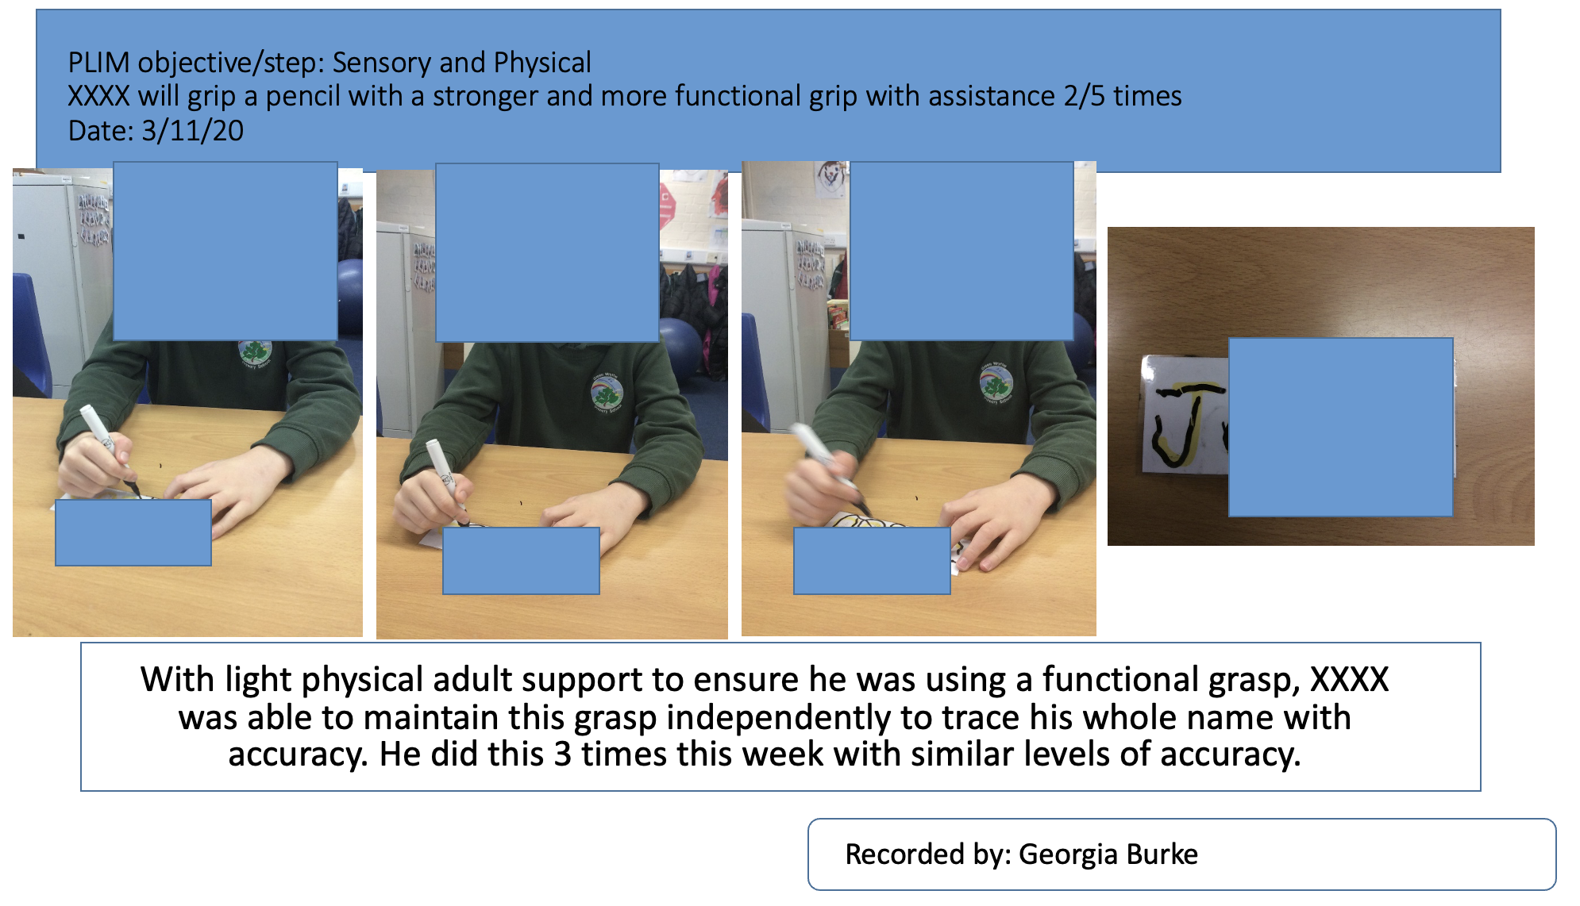
Example of Photo Evidence

Slide 10
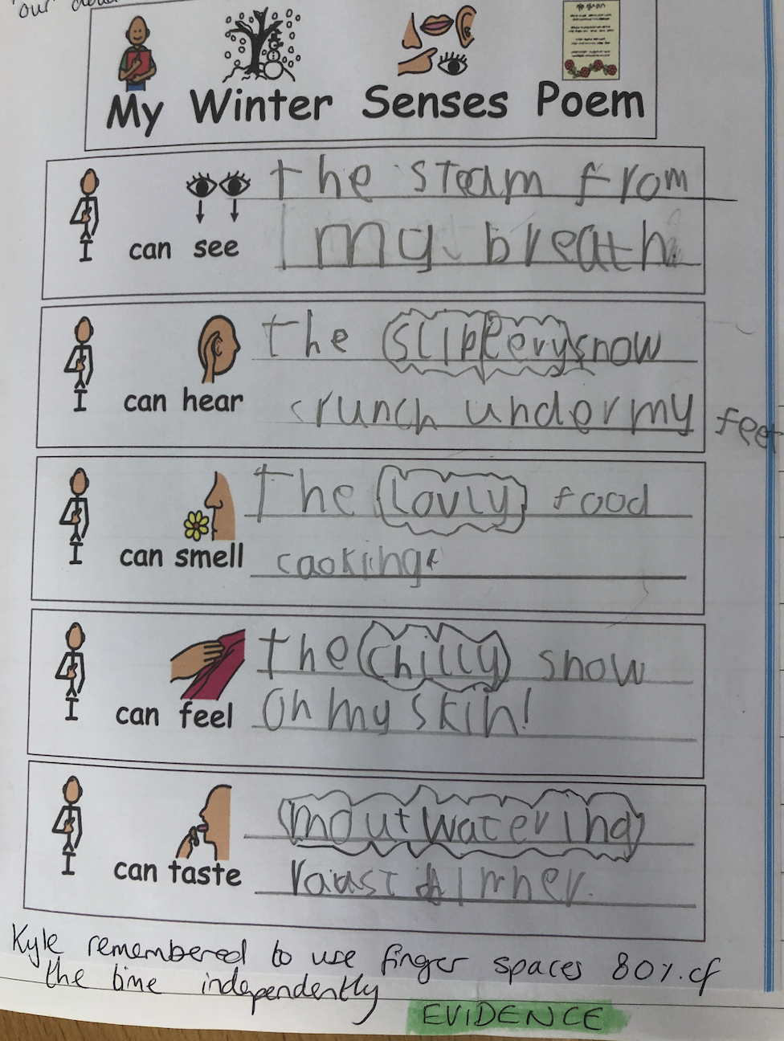
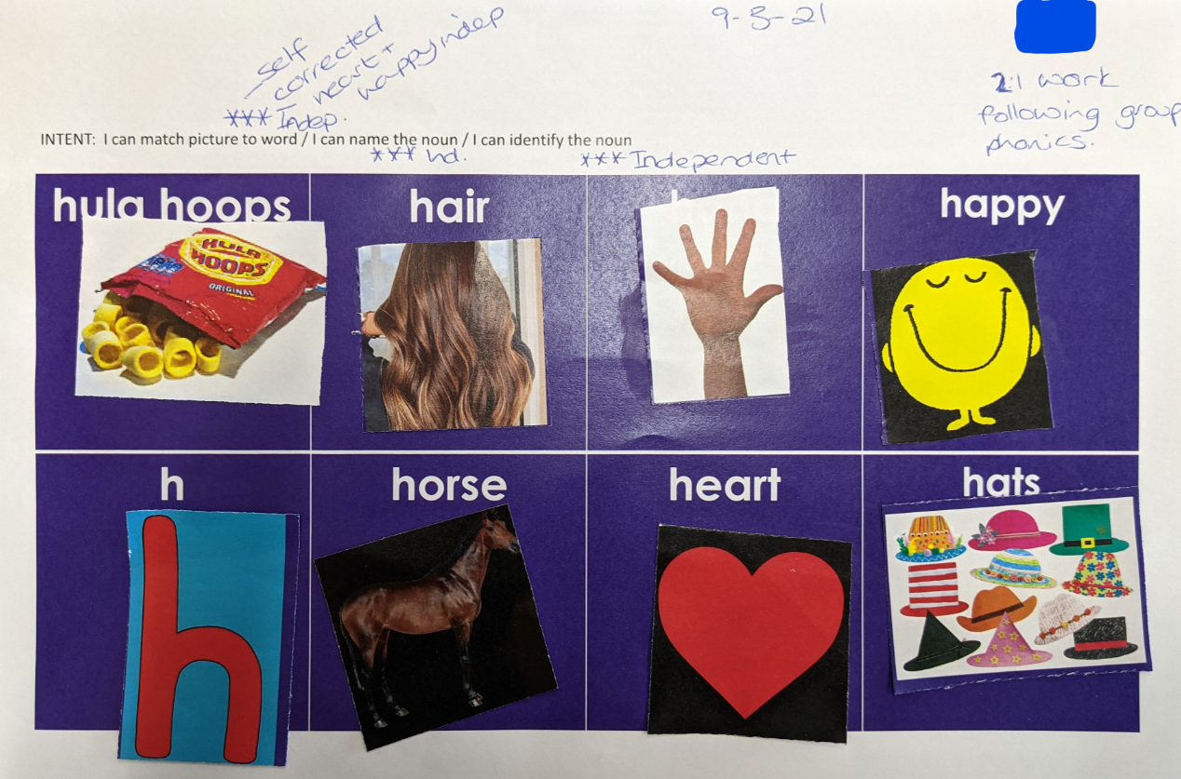
Example of Book Evidence

Slide 11
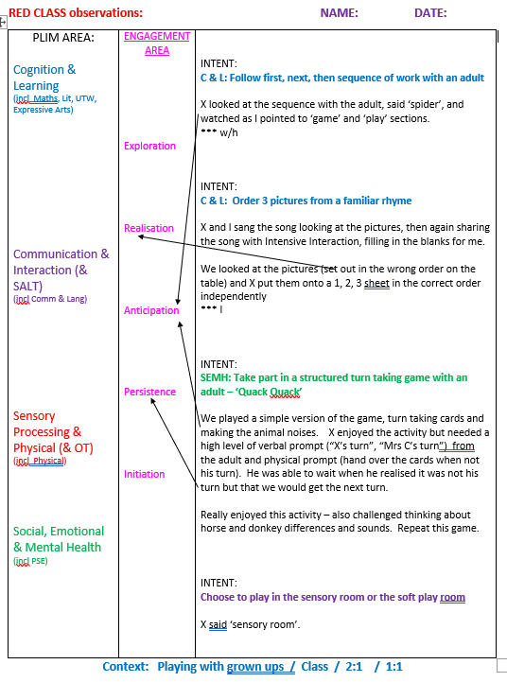
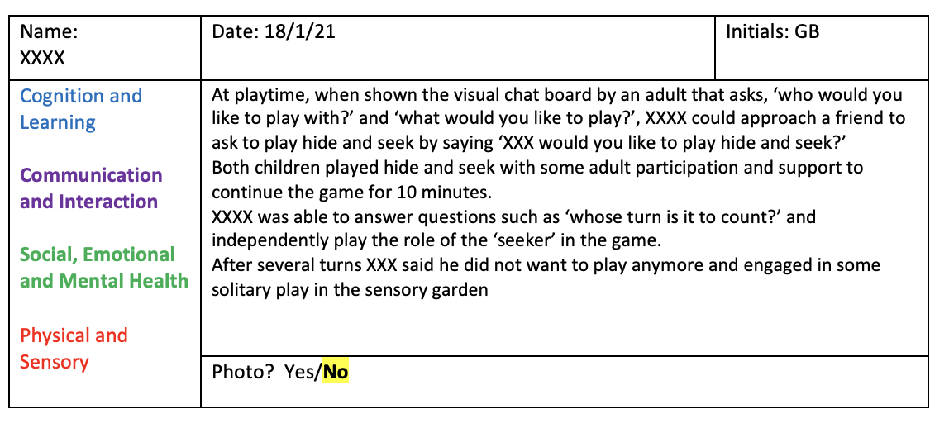
Example of an Observation for Evidence

Slide 12
PLIM Folder
Name

Slide 13
Questions
If you have any further questions please email them to rainbowsen@greenwrythe.org

